Slide 1


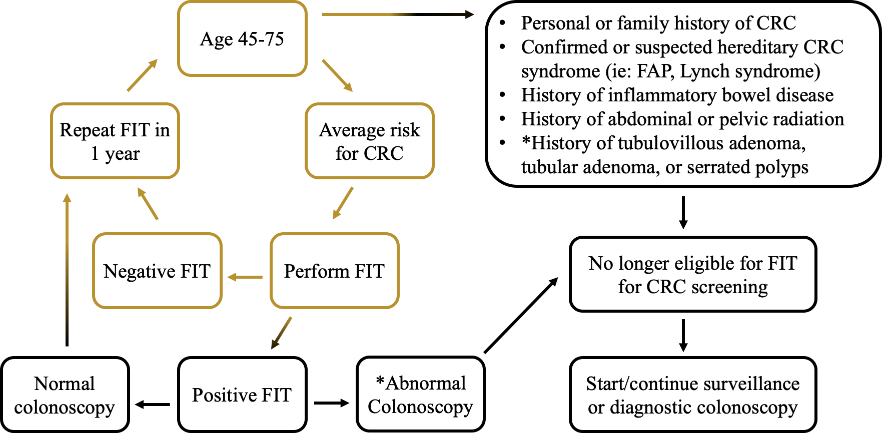
Improving Rates of Colorectal Cancer Screening through FIT Testing in Primary Care at the Iowa City Veterans Affairs Hospital
Charles Dylan Miks MD, Alice Xu MD, Paige Carlson MD, Truman Nguyen MD, Austin Mallory MD, Maluki Gwyndolyn Radford MD, Pranav Puri MD, Usamah ElBakkush MD, William Iverson MD
University of Iowa Department of Internal Medicine, Iowa City Veterans Affairs Hospital
Introduction
Gap Analysis
Interventions
Colorectal cancer (CRC) is the 3rd most common cancer in the U.S. and is a leading cause of cancer-related deaths
Fecal immunochemical testing (FIT) is noninferior to colonoscopy for detecting CRC in average risk patients
Patients in the Veterans Affairs health care system who decline CRC screening are more likely to prefer FIT
Current CRC screening rates at the Iowa City VA are lower than the national average (45% vs 58%)
The predominant modality for screening is colonoscopy (88%) compared to FIT (9%)
EQM
ICVA data includes eligible CRC screening patients without a PCP (41%), leading to inaccurate metrics
Patient Factors
Screening deferred
Resident Factors
Lack of resident-patient discussion/education
Systems
FIT kit not given due to lack of standardized procedure
In resident clinics, 64% of eligible patients received CRC screening
Test not returned or improper sample
No follow-up of results
PCP not alerted of results
Resident is unaware of how to obtain FIT kits
Population
Resident Education
Residents will be educated on FIT eligibility criteria, methods by which patients can obtain FIT kits, and patient education and shared decision making
Clinic Factors
FIT kits will be readily stocked and placed in a location that is easily accessible
Mailed FIT Initiative
The VA is in the process of implementing a nationwide program where FIT will automatically be mailed to qualified veterans
To ensure accurate data collection, interventions will target the resident clinics, which only include patients eligible for CRC screening who are also assigned a PCP
Aim Statement
Increase CRC screening rates for average risk patients in ICVA resident primary care clinics by 5-10% using FIT
Methods
Used Electronic Quality Measurement Portal (EQM) to obtain preliminary data for CRC screening rates at ICVA
Identified barriers to screening through gap analysis
Interviewed stakeholders, including primary care and GI clinic staff, laboratory technicians, patients, and VA performance improvement specialists
Clarified current vs ideal states for CRC screening
FIT Eligibility
Next Steps
References
Review EQM data to re-assess screening rates in White team clinic after interventions have been implemented
Integrate current intervention with the VISN initiative for automated mailed FIT kits, with a focus on patient education
Continue collaboration with laboratory and ancillary team in resident clinic to ensure patient appropriately receives and returns FIT kits
Standardize how patients receive FIT kits
Centers for Disease Control and Prevention. (n.d.). USCS data visualizations - CDC. Centers for Disease Control and Prevention. https://gis.cdc.gov/Cancer/USCS/#/AtAGlance/
Quintero, E., Castells, A., Bujanda, L., Cubiella, J., Salas, D., Lanas, Á., Andreu, M., Carballo, F., Morillas, J. D., Hernández, C., Jover, R., Montalvo, I., Arenas, J., Laredo, E., Hernández, V., Iglesias, F., Cid, E., Zubizarreta, R., Sala, T., Ponce, M., … COLONPREV Study Investigators (2012). Colonoscopy versus fecal immunochemical testing in colorectal-cancer screening. The New England journal of medicine, 366(8), 697–706. https://doi.org/10.1056/NEJMoa1108895
Robertson, Douglas J et al. “Baseline Features and Reasons for Nonparticipation in the Colonoscopy Versus Fecal Immunochemical Test in Reducing Mortality From Colorectal Cancer (CONFIRM) Study, a Colorectal Cancer Screening Trial.” JAMA network open vol. 6,7 e2321730. 3 Jul. 2023, doi:10.1001/jamanetworkopen.2023.21730
Shergill, Jaspreet et al. “Fecal immunochemical test (FIT) versus colonoscopy: Does knowing that a positive FIT requires a follow-up colonoscopy affect initial decision making in the US?.” Preventive medicine reports vol. 27 101825. 13 May. 2022, doi:10.1016/j.pmedr.2022.101825
Notes:
Use current intervention to address gap in this initiative, primarily patient education and shared-decision making
Early initiation of physician education of follow up of FIT results

