Slide 1
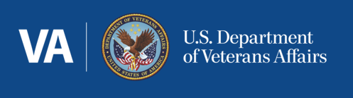
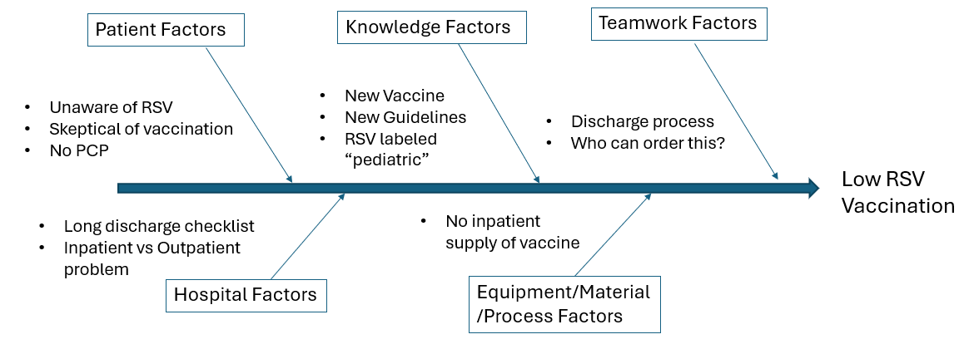
RSV Vaccinations at the Iowa City Veterans Affairs Hospital
A Work in Progress Quality Improvement Project
Mackenzie Walhof, MD; Tristan Bakerink, MD; James Burton, MD; Daniel Goering, MD; Robert Schoeneich, MD; Carlie Sorensen, MD; Quinn Vatland, MD; Carly Kuehn, MD
University of Iowa Health Care Internal Medicine Residency Program
BACKGROUND AND INTRODUCTION
GAP ANALYSIS
CONCLUSIONS/FUTURE PLANS
Respiratory Syncytial Virus (RSV) is an estimated cause of 60,000-160,000 hospitalizations and 6,000-10,000 deaths in the US annually in adults over the age of 65.
Adults hospitalized with RSV had worse outcomes in terms of oxygen therapy requirement, high flow nasal cannula (HFNC) or noninvasive ventilation (NIV) use, admission to an intensive care unit, and invasive mechanical ventilation or death compared to COVID and influenza.
In 2023, 2 FDA-approved RSV vaccines for adults >60 years old became available. Arexvy is produced by GSK and Abrysvo is produced by Pfizer.
Current recommendations by the CDC guidelines are that “adults 60 years of age and older may receive a single dose of RSV vaccine using shared clinical decision-making”
The next steps in this project are to perform early data analysis on pre-intervention data and then to move forward into choosing and implementing an intervention.
Overall, while we are early in this project, we are optimistic about this project and the benefit increased RSV vaccination will have on our veteran population. We anticipate and look forward to overcoming barriers during the intervention and implementation portion of this project.
PROPOSED PROCESS
REFERENCES
SOLUTION APPROACH MATRIX
Ison, MD MS, M., & Nam, MD, MSCI, H. (2024, January 9). Respiratory syncytial virus infection in adults. Retrieved from UpToDate.
Centers for Disease Control and Prevention. (2024, March 1). For Healthcare Professionals: Vaccination for Older Adults| CDC.” Retrieved from https://www.cdc.gov/vaccines/vpd/rsv/hcp/older-adults.html
Centers for Disease Control and Prevention. (2024, January 18). Respiratory Syncytical Virus Infection (RSV). Retrieved from https://www.cdc.gov/rsv/about/prevention.html
Cheng, Tony MD; Kreitman, Kyle R. DO; Baidoo, Leonard MD; Waters, Bradford MD. S3316 Vaccinations in the VA - A Quality Improvement Project to Improve Vaccination Rates in Patients With Inflammatory Bowel Disease on Immunomodulating Agents at a Mid-South VA Hospital. The American Journal of Gastroenterology 116():p S1367, October 2021. | DOI: 10.14309/01.ajg.0000786796.22458.de
Crouse BJ, Nichol K, Peterson DC, Grimm MB. Hospital-based strategies for improving influenza vaccination rates. J Fam Pract. 1994 Mar;38(3):258-61. PMID: 8126406.
National Center for Veterans Analysis and Statistics. (2022, September 7). Veteran Population. Retrieved from https://www.va.gov/vetdata/veteran_population.asp.
During admission, eligible patient identified as being not vaccinated against RSV
Patient offered RSV vaccine and provided information by provider
Greater impact
Adding RSV vaccination to admission order set
Add RSV vaccination reminder to inpatient discharge summary templates
Impact
Patient declines RSV vaccine
Patient accepts RSV vaccine
INTRODUCTION
Email residents and pharmacists on inpatient teams to remind them RSV is available for inpatient use (after we work on this) if deemed appropriate
Post RSV vaccine reminders in resident work rooms
Many patients admitted to an inpatient service at ICVA are eligible for the RSV vaccine. We suspect this population also represents a group more at risk for serious complications from an RSV infection and therefore may have more benefit than an outpatient group. Patients admitted to an inpatient service may also not have outpatient follow-up where they may be offered an RSV vaccine.
While we currently have the capacity to provide RSV vaccines on an inpatient basis, we believe this is not being ordered on a regular basis.
We propose to increase RSV vaccination for eligible admitted veterans.
Order placed by provider for RSV vaccine
Less Impact
Send out email to residents about our proposed RSV inpatient vaccination project at the beginning of study period and periodically thereafter
Pharmacy provides, nurse administers vaccine prior to discharge
Figure 1.
Proposed process map for identification of patients admitted to ICVA who are eligible for RSV vaccination and administration of vaccine to patients who are interested.
Low Effort
Effort
High Effort
CURRENT STAGE OF PROJECT
Percentage of Iowa Veterans >60 y/o
ACKNOWLEDGEMENTS
Data collection with pharmacy and informatics colleagues at the VA to ascertain vaccination rates of veterans admitted to a medical team at time of admission and discharge.
Additional data collection: patient’s demographics, comorbidities, and other vaccination rate including vaccination against influenza, COVID, and pneumonia.
We want to thank Dr. Carly Kuehn for mentorship and guidance both through initiation of this project as well as prior projects.
Thank-you to Traviss Tubbs and the rest of the Pharmacy group at the Iowa City VA for assistance in data collection and intervention planning.
Thank-you to the informatics department at ICVA for assistance in data collection.
Figure 2.
Percentage of veterans in the state of Iowa age 60 or older and therefore meeting the age criteria for eligibility of RSV vaccination per CDC Guidelines
University of Iowa Internal Medicine Residency Program, Iowa City Veterans Affair

